Slide 1
document MANAGEMENT SYSTEM: USE and STRUCTURE
Meeting
1 February, 2012

Slide 2
SUMMARY
AS IS
FOLDER PROPOSAL
FOLDER MAPPING (with Txacoli)
PROJECT DOCUMENT PROPOSAL
SEARCH AND CUSTOMIZE FILTERS
HOW TO DO IT

Slide 3

AS IS
Ad-hoc: No regular use of AGS central DMS.
ThirdParty: Use Txacoli.
MOSS: Use DMS.
Teamsite: Use txacoli.
BI: Uses Txacoli.
NO ALL TEAMS ARE USING DMS
DMS Structure:
Root
No defined criteria.
Departments
…
Websolutions
MOSS
Teamsite
Serv. Man.
WIP – Technical Office
Governan.
QA
Project Folder
Project 1
Project 6 (Customer)
Project N (Name)

Slide 4

TO BE – New Folder Structure
DMS Structure:
Root
Websolutions
MOSS
…
SITE
BCN OWNERSHIP
(*) Atributtes
WIP - Projects
LIBRARY
Projects Library
ID Project - name - …
FOLDER
ID Project - name - …
Project 1
Project N
ID Project - name - …
CUSTOMIZE VIEWS
3P
BI
TS
MOSS

Slide 5
IMPORTANT – THIRDPARTY PROJECTS
(*) With thirdparty projects (p.e. zurich, etc..)
NO SHAREPOINT USE:
- MANTAINING TXACOLI AS MAIN REPOSITORY
- STRUCTURE DEFINED LIKE 2009 AND 2010

Slide 6

TO BE – New Project Folders
SITE
Project Nomenclature
WIP - Projects
LIBRARY
Offer-line
Entity Code Abbr. (Customer)
SAP ID
Project Name
Project s Library
FOLDER
Project Name
Define
Feasibility study and RFP
Innovate
Business Requirement Analysis, Planning and Contract
Functional and technical specs.
Design
Design
Project Folders
Build
System and integration Test
Validate
User Acceptance Test
Product Set-up
Operate
Warranty

Slide 7
TO BE – Project Nomenclature
PROJECT
CLEARQUEST
BAU
Set-up Project
SAP
Set-up Internal Project
…
Use the same project nomenclature in all tools like DMS, Clearquest, SAP.
Offer-line
Abbreviature | Name
SSP (*) | Entity specific solutions - Spain
Entity Code Abbr. (Customer)
(*) See Entity Name annex document
LINK
SAP ID
Id given by sap tool (DP code)
Project Name
‘Name of the project’
Notes:
!!CONFIRMAR PARA THIRDPARTY, LA ANTIGUA NOMENCLATURA !!
- LINK PARA LAS ENTITIES

Slide 8
TO BE – Project Structure Mapping (Txacoli)
SITE
WIP - Projects
Project s Library
LIBRARY
FOLDER
Project Name
Feasibility study and RFP
Requerimentos RFP
Business Requirement Analysis, Planning and Contract
Valoración oferta Contrato
Functional and technical specs.
Análisis
Design
Build
Desarrollo
System and integration Test
Testing IT
User Acceptance Test
Testing User
Product Set-up
Puesta a producción
Warranty
Notes:
- DP: mirar si hay que añadirlo también en WDP o ponerlo solo ahí.

Slide 9
TO BE – Project Document template list
Business Requirements Delivery
IT Solutions Delivery
G1
G2
G3
G4
G5
Engineering process
Feasibility study
Business Requirement Analysis
Funct. & Tech. Spec.
Design
Build
System & Integration Test
User Acceptance Test
Prod set-up
Warranty
BAU
Contract with client
Commercial Process
DP
AR
QDC
SLA
QDC
Plan & monitor
Manage Project
IRM Ctriticality assess.
PMP
PPR
close out report
Project docs
Feasibility study
Detailed specs
Business Requirements
Funct & Tech specs
Software components
User & Admin guides
Business case
Technical study
Tests & validation
Testing strategy
Tests cases
Unit & Integ. tests results
User tests results
Tests plan
Tests sign-off
Acceptance sign-off
Supplier
Manage Suplier
RFI
RFP
Contract
Install doc
AXA Tech
Fiche INIT
Install doc
Operating manual
Delivery sign-off
QA & CM
Manage Configuration & Assurance Quality
QA Plan
QA Review
QA Review
CMP
CM Audit
CM Audit
SOX
Manage SOX IT
SOX Internal Control files
Manage Changes

Slide 10
TO BE – Project Document template list
DOCUMENT | TEMPLATE | HYPERLINK | RESPONSIBLE
Document proposal | DP - 01 - simple Check List | Professional Services | Project Manager
 | Document Proposal AutoTemplate (DP Auto). | Professional Services
Project plan | PP/PMC Template of MS Project schedule | OPAL | Project Manager
 | Template of Project estimation worksheet | OPAL
 | Template of Project charter | OPAL
 | Template of PMP (Project Management Plan) | OPAL
 | Template of end of Project "light" report | OPAL

Slide 11
TO BE – Project Document template list
DOCUMENT | TEMPLATE | HYPERLINK | RESPONSIBLE
Requirement document. | REQM Template of requirements management plan.doc | OPAL | Customer/IT Business Analyst
 | Template of customer needs document, includes traceability matrix | OPAL
Functional document | REQM Use case _Template_EN.doc | OPAL | IT Business Analyst
Technical document | REQM Template de spécifications techniques | OPAL | IT System Analyst
 | REQM Sample of specification | OPAL

Slide 12
TO BE – Project Document template list
DOCUMENT | TEMPLATE | HYPERLINK | RESPONSIBLE
Testing document | PPQA Template of test plan | OPAL | Test Manager
 | PPQA Template of Documentary Audit Template of Test Plan/execution Template of Projects test coverage Template of Document usability | WIP-QA
Deployment manual | No template | -
User/Admin Manual | No template | -
Release notes | Template of delivery receipt.doc | OPAL | IT System Analyst

Slide 13
CUSTOMIZED VIEWS: Document Sorting
DMS VIEWS:
ID Project - name - …
(*) Atributtes
ID Project - name - …
ID Project - name - …
NEW
Service Unit
CUSTOMIZE VIEWS
3P
BI
TS
MOSS
Why
Easy to implement “Service Unit” attribute and new ones.
Easy to change/extend if needed.
It is a required attribute when upload any document/folder.
Personalized views for each team, group and/or user.
Notes:
Problema: fácil atribut project_type per a doc, pero per defecte no es pot fer per a Folders, s’ha de personalitzar. Mirar: http://www.eggheadcafe.com/software/aspnet/31906099/doc-library--set-folder.aspx
http://social.technet.microsoft.com/forums/en-US/sharepointgeneral/thread/b708b4b8-700c-481f-9e63-97550dcb0be5
http://techtrainingnotes.blogspot.com/2007/08/sharepoint-how-to-create-links-from.html
FALTA: CREAR TEMPLATES COMUNS PER A TENIRLOS JA PASAR-HO JA ALS GRUPS

Slide 14
CUSTOMIZED VIEWS – How to do it
Create new_folder with attribute capabilities (Service Unit)
Replace default folder type with new_folder type
Add “Service Unit” to document type.
Create new column view
Create view using this attribute.

Slide 15
CUSTOMIZED VIEWS– New folder, add attribute
SITE
WIP - Projects
Project Name
LIBRARY
WIP-PROJECTS | PROJECT NAME
1.- site administration > gallery > Content type | 4.- WIP-project -> Settings -> Advanced Settings -> Allow management of content types? "yes"
2.- create -> "New_folder" / parent content type from: "Folder content type" / parent content type: "folder" /put into existing group: "folder content type" | 5.- WIP-project -> Settings -> Advanced Settings -> Display "New Folder" command on the New menu? "No“
3.- edit it on Add from new site column -> create column -> "Service Unit" -> choice > put this column existing group : "custom columns" -> each choice information "BI, Thirdparty, MOSS, Teamsite" -> enter default value : "Thirdparty" | 6.- WIP-project -> setting -> document library settings --> content type --> Add from existing site content types --> Add "Service Unit"
 | 7.- WIP-project -> setting -> document library settings --> content type --> Change new button order and default content type -> "New_Folder" to visible -> (if applicable) Folder not visible.
 | 8.- WIP-project -> setting -> document library settings --> columns --> Add from existing site columns -> "Service Unit"
 | 9.- WIP-project > Settings > Content type -> "Document" -> Columns -> Add from existing site or list columns -> "Service Unit"

Slide 16
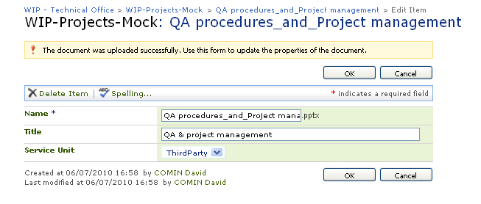
CUSTOMIZED VIEWS– Document upload
NEW
Service Unit

Slide 17
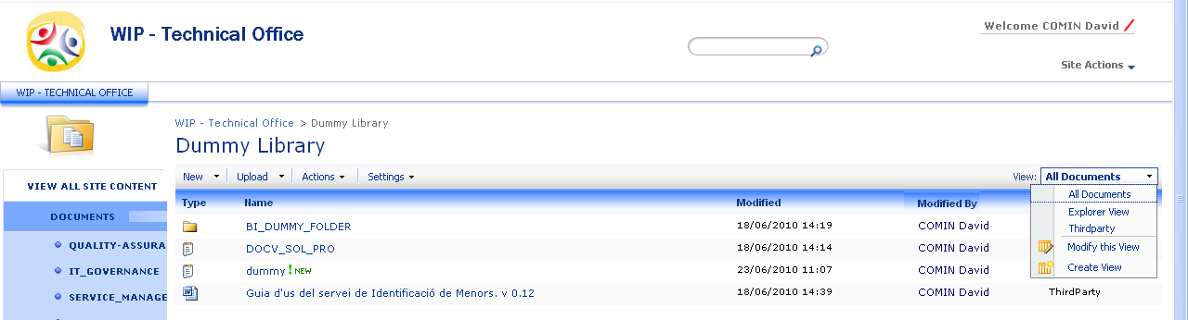
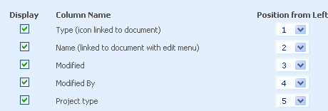
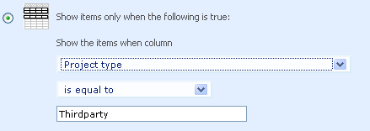
CUSTOMIZED VIEWS – Create view
DMS VIEW:
1
2
3
Service Unit
Service Unit

Slide 18
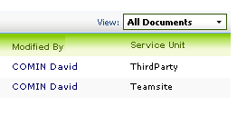
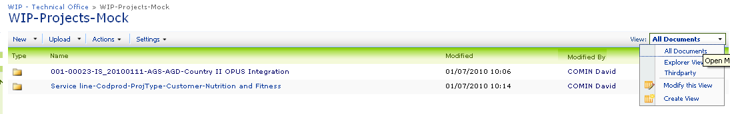
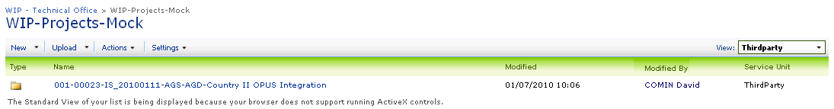
CUSTOMIZED VIEWS – Customize view
1
2
3

Slide 19
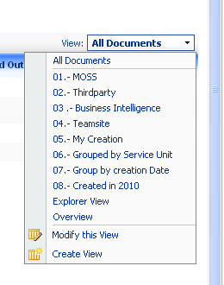
CUSTOMIZED VIEWS – Default created views

Slide 20
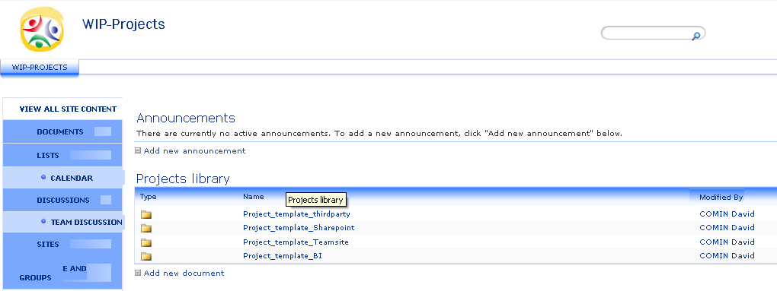
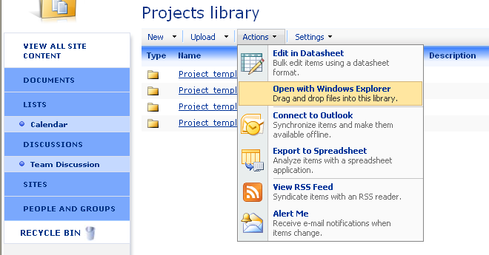
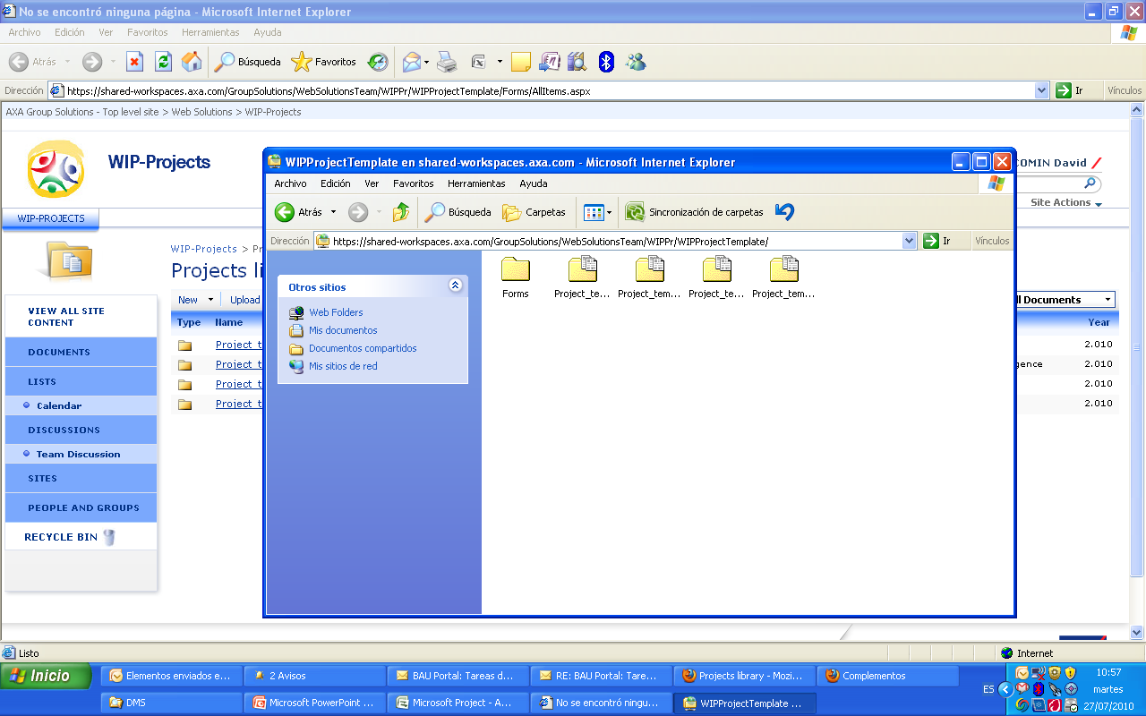

CREATE A PROJECT– New Project (with Internet Explorer)
1
https://shared-workspaces.axa.com/GroupSolutions/WebSolutionsTeam/WIPPr
2
COPY-PASTE your service unit template & change the name
3
4

Slide 21
STARTING ACTIVITIES
ACTIVITY | DUE TO
Project storing documents in AGS Sharepoint | 01/08/2010

